Slide 1
kathará lab
two-hosts
Version | 1.0
Author(s) | G. Di Battista, M. Patrignani, M. Pizzonia, M. Rimondini
E-mail | contact@kathara.org
Web | http://www.kathara.org/
Description | setting up a network between two virtual machines; kathara version of netkit lab two-hosts version 2.2

Slide 2
copyright notice
All the pages/slides in this presentation, including but not limited to, images, photos, animations, videos, sounds, music, and text (hereby referred to as “material”) are protected by copyright.
This material, with the exception of some multimedia elements licensed by other organizations, is property of the authors and/or organizations appearing in the first slide.
This material, or its parts, can be reproduced and used for didactical purposes within universities and schools, provided that this happens for non-profit purposes.
Information contained in this material cannot be used within network design projects or other products of any kind.
Any other use is prohibited, unless explicitly authorized by the authors on the basis of an explicit agreement.
The authors assume no responsibility about this material and provide this material “as is”, with no implicit or explicit warranty about the correctness and completeness of its contents, which may be subject to changes.
This copyright notice must always be redistributed together with the material, or its portions.

Slide 3

two hosts
a simple network with two hosts connected to the same collision domain
eth0
pc1
10.0.0.1/24
collision domain A
eth0
pc2
10.0.0.2/24
10.0.0.0/24

Slide 4
step 1 – creating the vms
host machine
user@localhost:~$ vstart --eth 0:A –n pc1
========================= Starting Lab ==========================
bb423a23157cde000990e9a94dab36928d0ba0aecff38570d653e8b60b429550
6ff9da2ece5f418d7fbf89f0b382e33bc9a4aadbe90f9ebaa1c2b203f005a76a
user@localhost:~$ vstart --eth 0:A –n pc2
========================= Starting Lab ==========================
Error response from daemon: network with name netkit_nt_A already exists
c2ad58fae2a38b7ad7f003695c20bdac192b14f7b3bdd2b0f32294741d7b21f1
pc1 is created and a console window opens for pc1
pc2 is created and a console window opens for pc2

Slide 5
step 2 – configuring network interfaces
pc1
pc1:~# ifconfig eth0 10.0.0.1 netmask 255.255.255.0 broadcast 10.0.0.255 up
pc1:~# █
pc2
pc2:~# ifconfig eth0 10.0.0.2 netmask 255.255.255.0 broadcast 10.0.0.255 up
pc2:~# █

Slide 6
step 3 - ping
pc1
pc1:~# ping 10.0.0.2
PING 10.0.0.2 (10.0.0.2) 56(84) bytes of data.
64 bytes from 10.0.0.2: icmp_seq=1 ttl=64 time=2.65 ms
64 bytes from 10.0.0.2: icmp_seq=2 ttl=64 time=0.357 ms
64 bytes from 10.0.0.2: icmp_seq=3 ttl=64 time=0.380 ms
64 bytes from 10.0.0.2: icmp_seq=4 ttl=64 time=0.349 ms
64 bytes from 10.0.0.2: icmp_seq=5 ttl=64 time=0.348 ms
--- 10.0.0.2 ping statistics ---
5 packets transmitted, 5 received, 0% packet loss, time 4078ms
rtt min/avg/max/mdev = 0.348/0.818/2.656/0.919 ms
pc1:~# █
pc1 and pc2 can reach each other

Slide 7
step 4 – a look at the packets
let’s look at the packets exchanged on collision domain A
we use tcpdump, a network sniffer that is widely available on linux boxes
number of bytes captured per
packet (default is 68)
TCPDUMP(8) TCPDUMP(8)
NAME
tcpdump - dump traffic on a network
SYNOPSIS
tcpdump [ -AdDeflLnNOpqRStuUvxX ] [ -c count ]
[ -C file_size ] [ -F file ]
[ -i interface ] [ -m module ] [ -r file ]
[ -s snaplen ] [ -T type ] [ -w file ]
[ -E spi@ipaddr algo:secret,... ]
stores the packets
to file

Slide 8
step 4 – a look at the packets
ping from pc1
pc1
pc1:~# ping 10.0.0.2
PING 10.0.0.2 (10.0.0.2) 56(84) bytes of data.
64 bytes from 10.0.0.2: icmp_seq=1 ttl=64 time=6.94 ms
64 bytes from 10.0.0.2: icmp_seq=2 ttl=64 time=0.906 ms
64 bytes from 10.0.0.2: icmp_seq=3 ttl=64 time=0.864 ms
--- 10.0.0.2 ping statistics ---
3 packets transmitted, 3 received, 0% packet loss, time 2033ms
rtt min/avg/max/mdev = 0.864/2.906/6.948/2.858 ms
pc1:~# █

Slide 9
step 4 – a look at the packets
at the same time, sniff from pc2 (ctrl+C to interrupt)
pc2
pc2:~# tcpdump -tenni eth0
tcpdump: verbose output suppressed, use -v or -vv for full protocol decode
listening on eth0, link-type EN10MB (Ethernet), capture size 96 bytes
19:27:17.899782 arp who-has 10.0.0.2 tell 10.0.0.1
19:27:18.002578 arp reply 10.0.0.2 is-at fe:fd:0a:00:00:02
19:27:18.004384 IP 10.0.0.1 > 10.0.0.2: icmp 64: echo request seq 1
19:27:18.005806 IP 10.0.0.2 > 10.0.0.1: icmp 64: echo reply seq 1
19:27:18.920463 IP 10.0.0.1 > 10.0.0.2: icmp 64: echo request seq 2
19:27:18.920605 IP 10.0.0.2 > 10.0.0.1: icmp 64: echo reply seq 2
6 packets captured
6 packets received by filter
0 packets dropped by kernel
pc2:~# █

Slide 10
step 4 – looking at the packets with a graphical interface
same as before, but store sniffed packets into file capture.pcap (on the host machine)
the (real) home directory of the current user is made available inside the vm under /hosthome
pc2
pc2:~# tcpdump -tenni eth0 -w /hosthome/capture.pcap
tcpdump: listening on eth0, link-type EN10MB (Ethernet), capture size 96 bytes
10 packets captured
10 packets received by filter
0 packets dropped by kernel
pc2:~# █

Slide 11
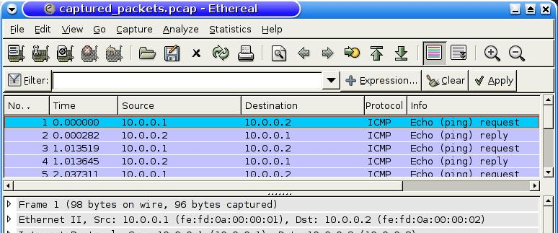
step 4 – looking at the packets with a graphical interface
open capture.pcap on the real host machine using a packet dissector (like, e.g., ethereal)

